Slide 1


x
Tickr
The async project co-pilot for teams on Discord.
Brilliant, Hoyeong, Jaemin, Cedric

Slide 2
01.
this scene might feel familiar

Slide 3
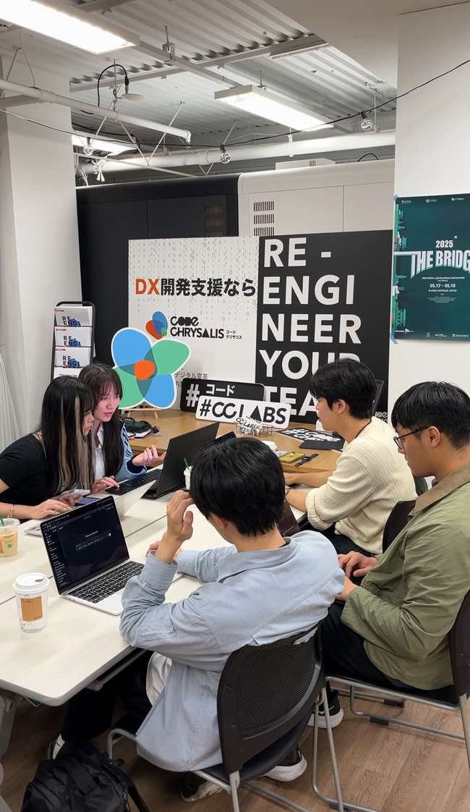
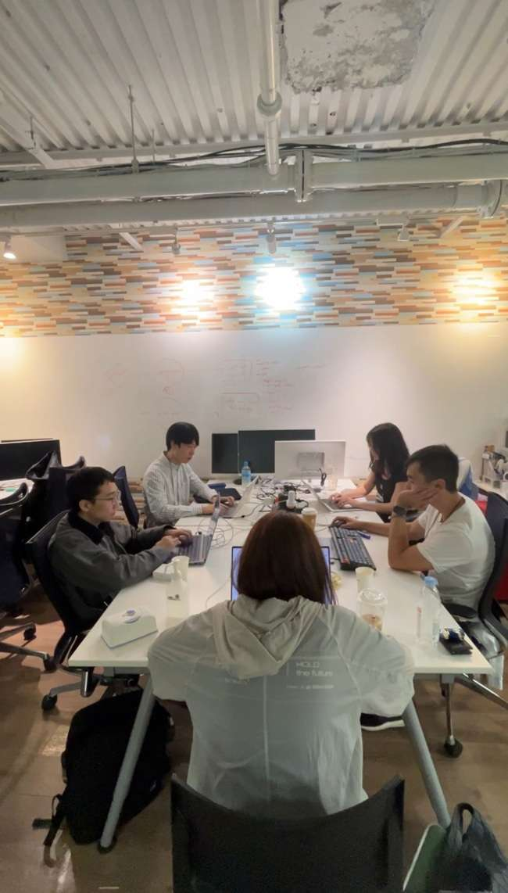
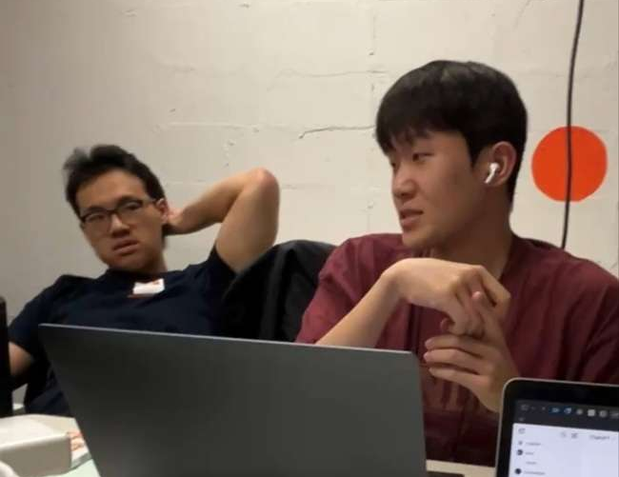
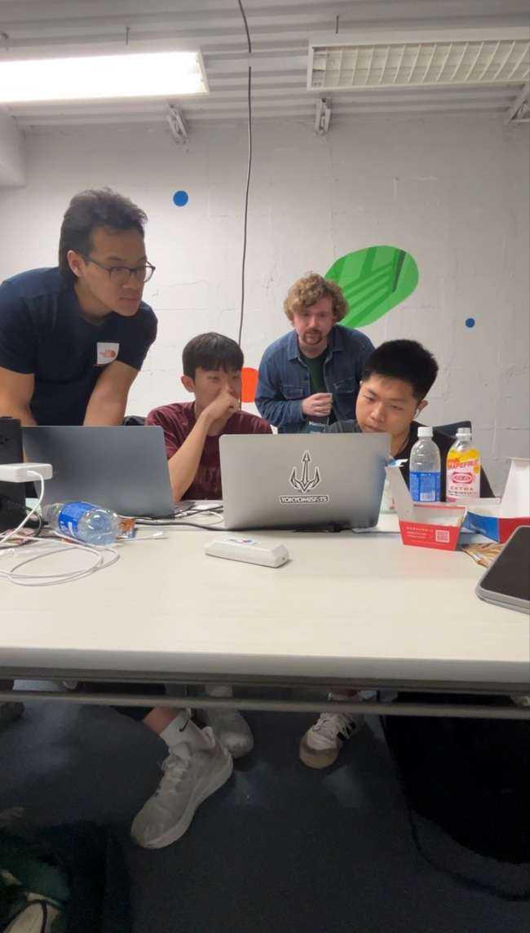
what they’re doing
too
many
ideas
no
direction
nobody
knows

Slide 4
2 hours later

Slide 5
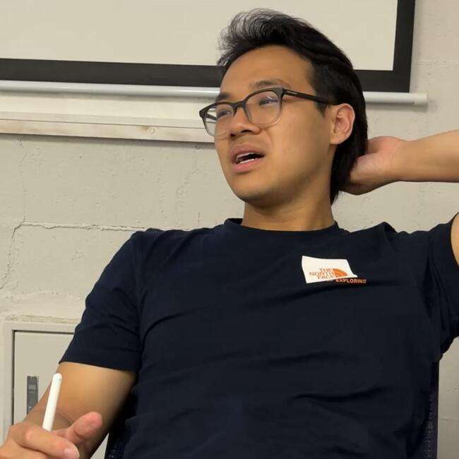
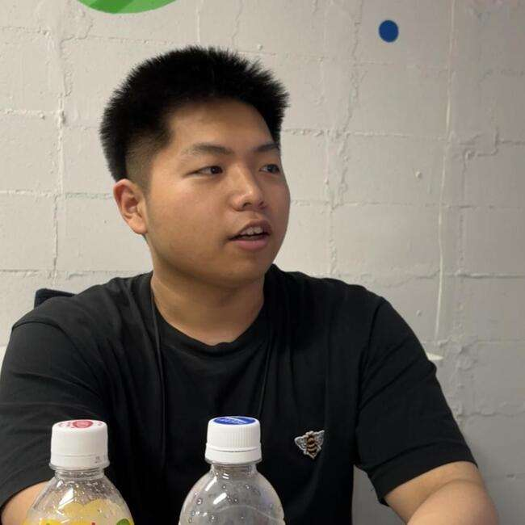
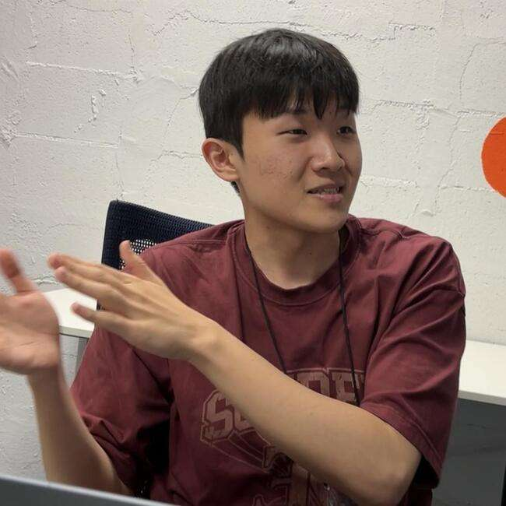

Slide 6
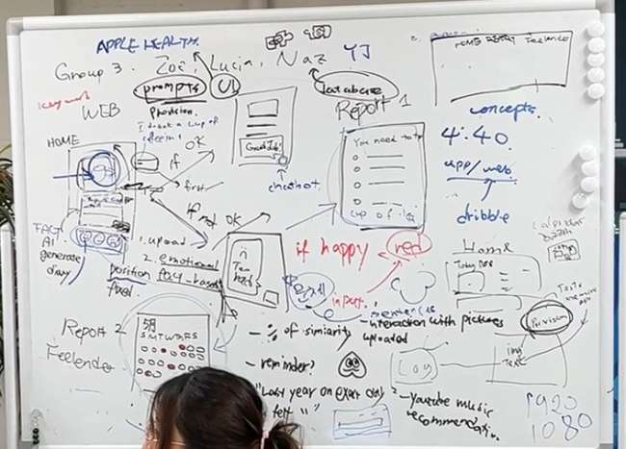
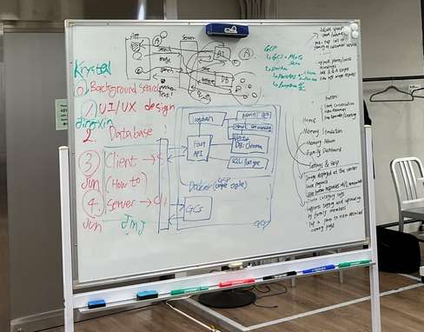
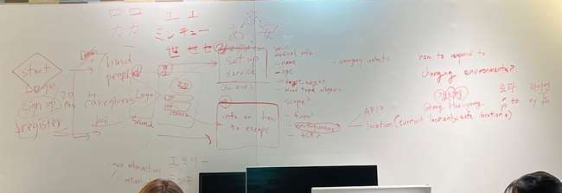
creative teams don’t fail from lack of ideas…

Slide 7
they fail from scattered thoughts, forgotten action items, and poor follow-through

Slide 8
so we built Tickr

Slide 9
02.
what if AI could start the conversation?

Slide 10
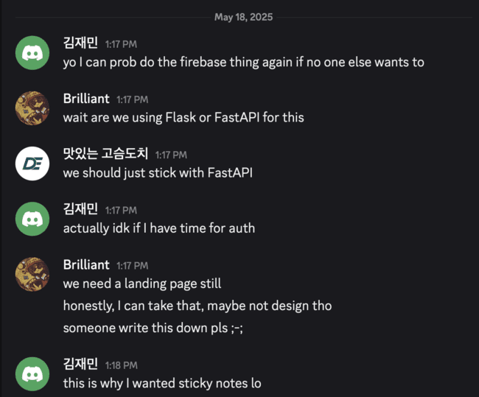
and turn messy chats

Slide 11
into clear, trackable tasks?

Slide 12
03.
live demo :)

Slide 13


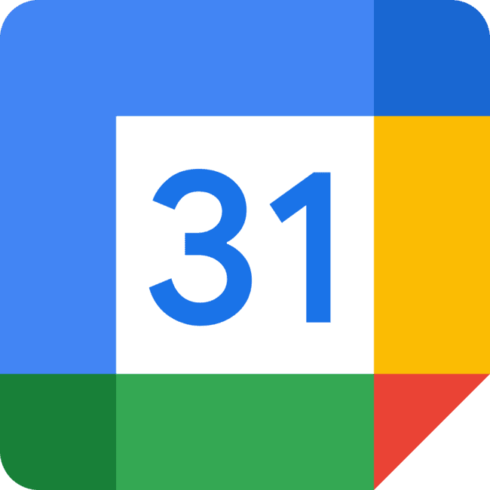
3 cool things
Chat Scraping
Google Calendar
Team-based
& async ticket generation
integration
assignment & accountability

Slide 14
04.
why this matters (market/impact)

Slide 15

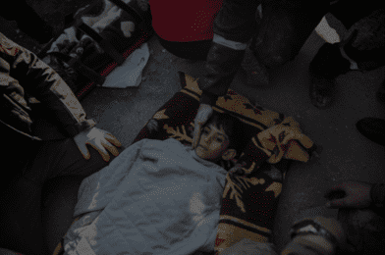
over 15,000 volunteers coordinated relief efforts via Discord

Slide 16
from ineffective communication
1.2$ trillion lost

Slide 17


what about?

Slide 18
05.
how it works (tech stack)

Slide 19



TechStack
Gemini
Google Calendar
FastAPI
discord.js
processing the chat data and generating tickets
for event creation
for REST endpoints
running on node.js

Slide 20
06.
future vision

Slide 21
improvements
further integrations
social aspect
Slack, Notion, Github & more
initiates gatherings with like-minded people in the company

Slide 22

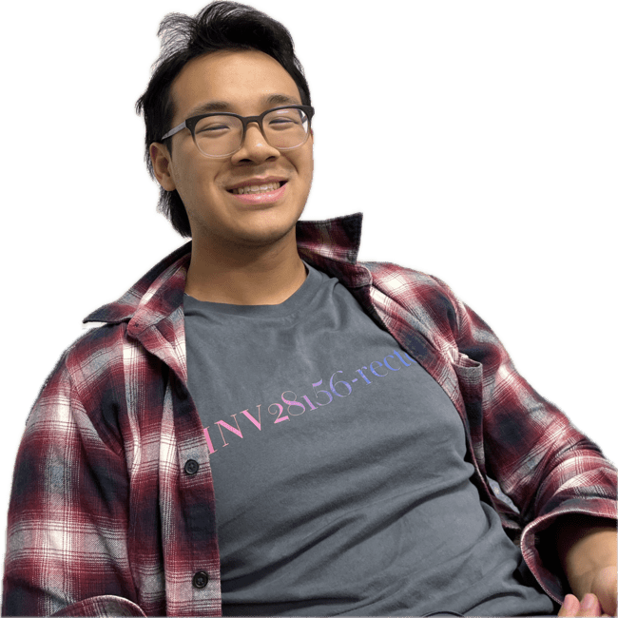
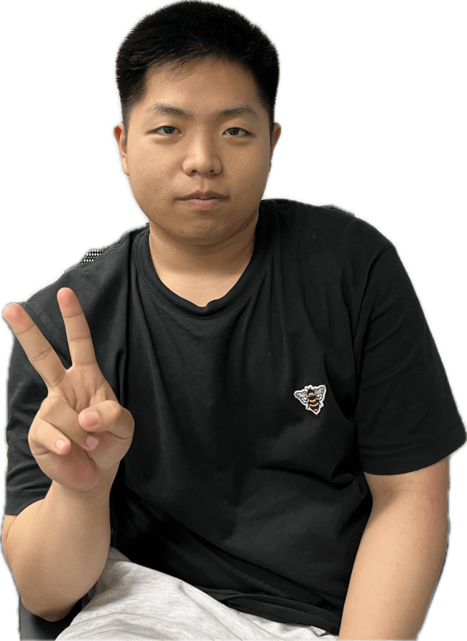
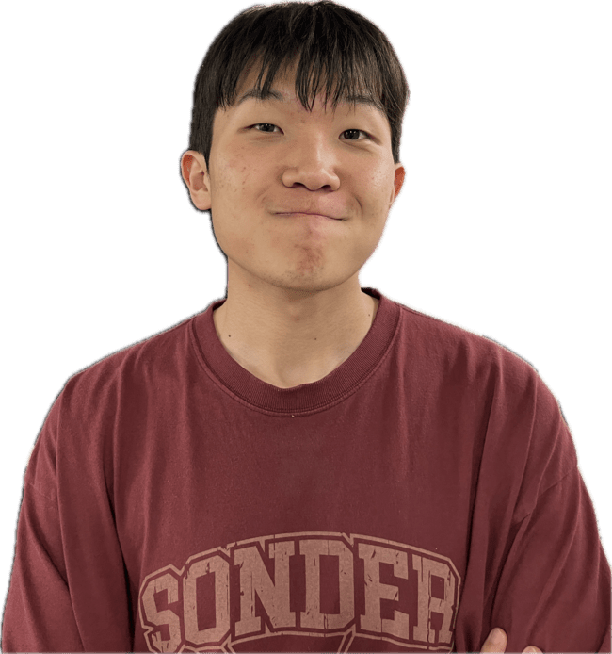
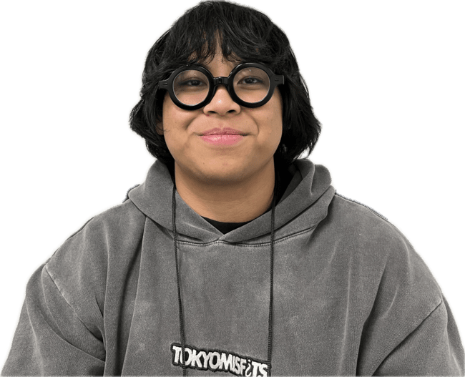


cedric
hoyeong
jaemin
brilliant
07.
the team

